Slide 1


Slide 2



Slide 3


IT Overview & Support

Slide 4



Insurance Overview – Baer Insurance

Slide 5
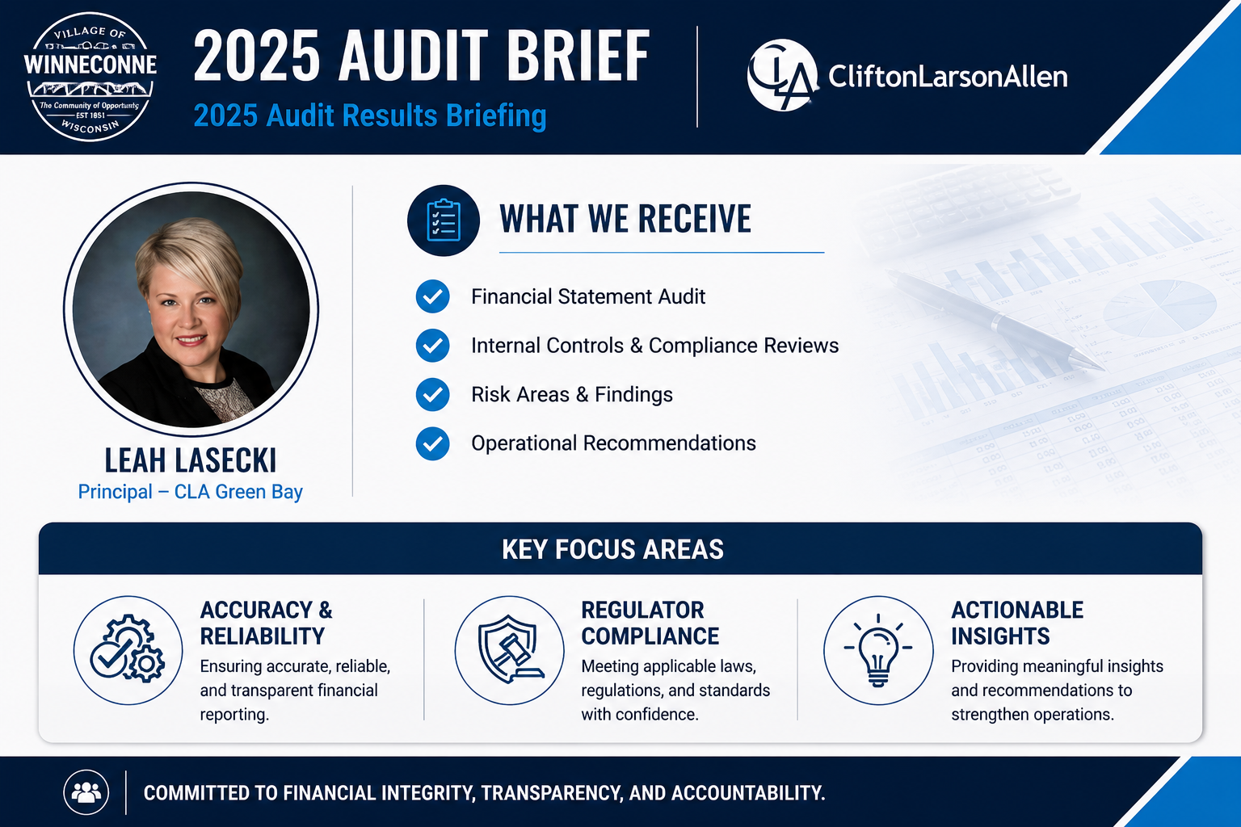



2025 Audit Brief
2025 Audit Results Briefing
What We Receive
Financial Statement Audit
Internal Controls & Compliance Reviews
Risk Areas & Findings
Operational Recommendations
3. Audit Brief – CLA
Accuracy & Reliability
Regulator Compliance
Actionable Insights

Slide 6
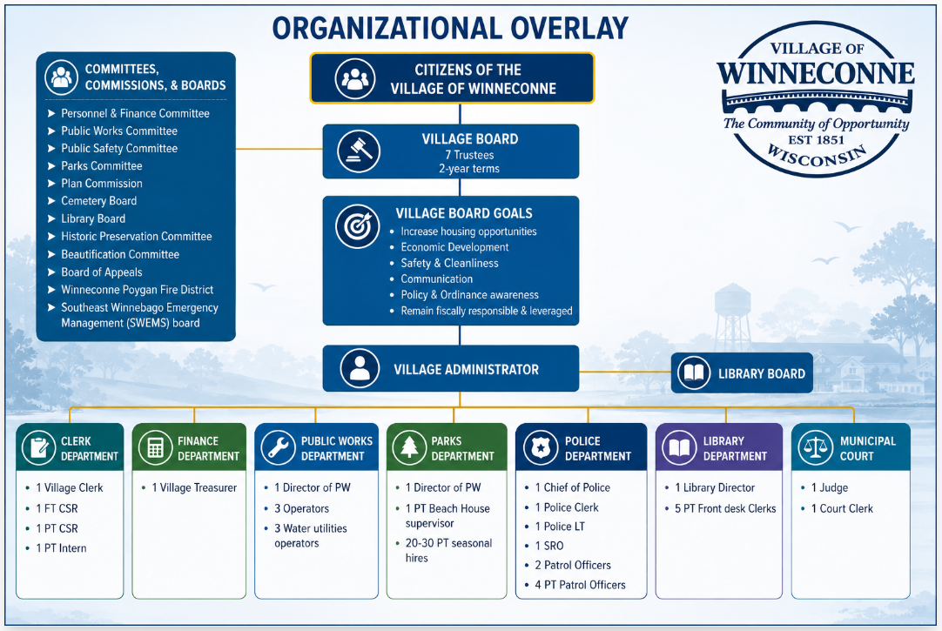


Slide 7

Financial Deep Dive
The goal of the following slides are to illustrate the following:
Capture historical, current, and future financial indicators & projections
Clearly articulate the data to shape future decision points
Provide assumptions, limitations, variables and risks
End state : Provide the board of trustee’s enhanced

Slide 8
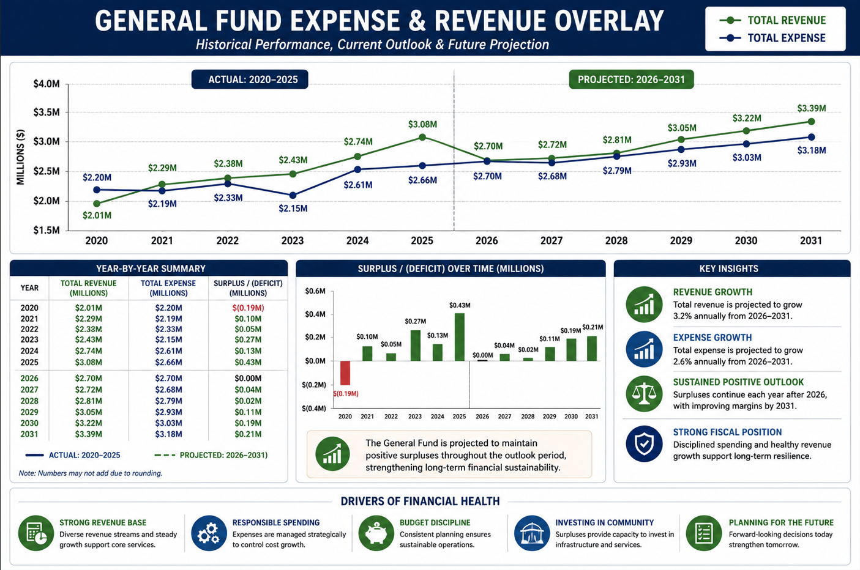
Financial Deep Dive

Slide 9
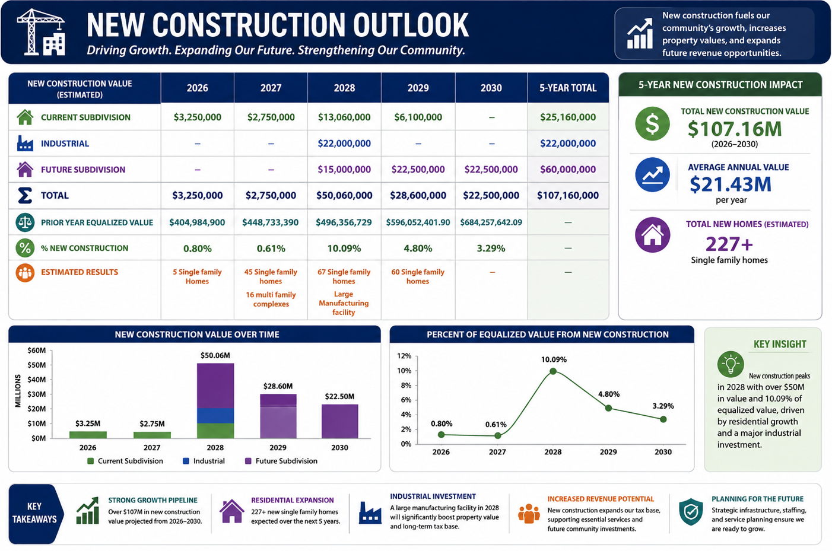
Financial Deep Dive
200+

Slide 10
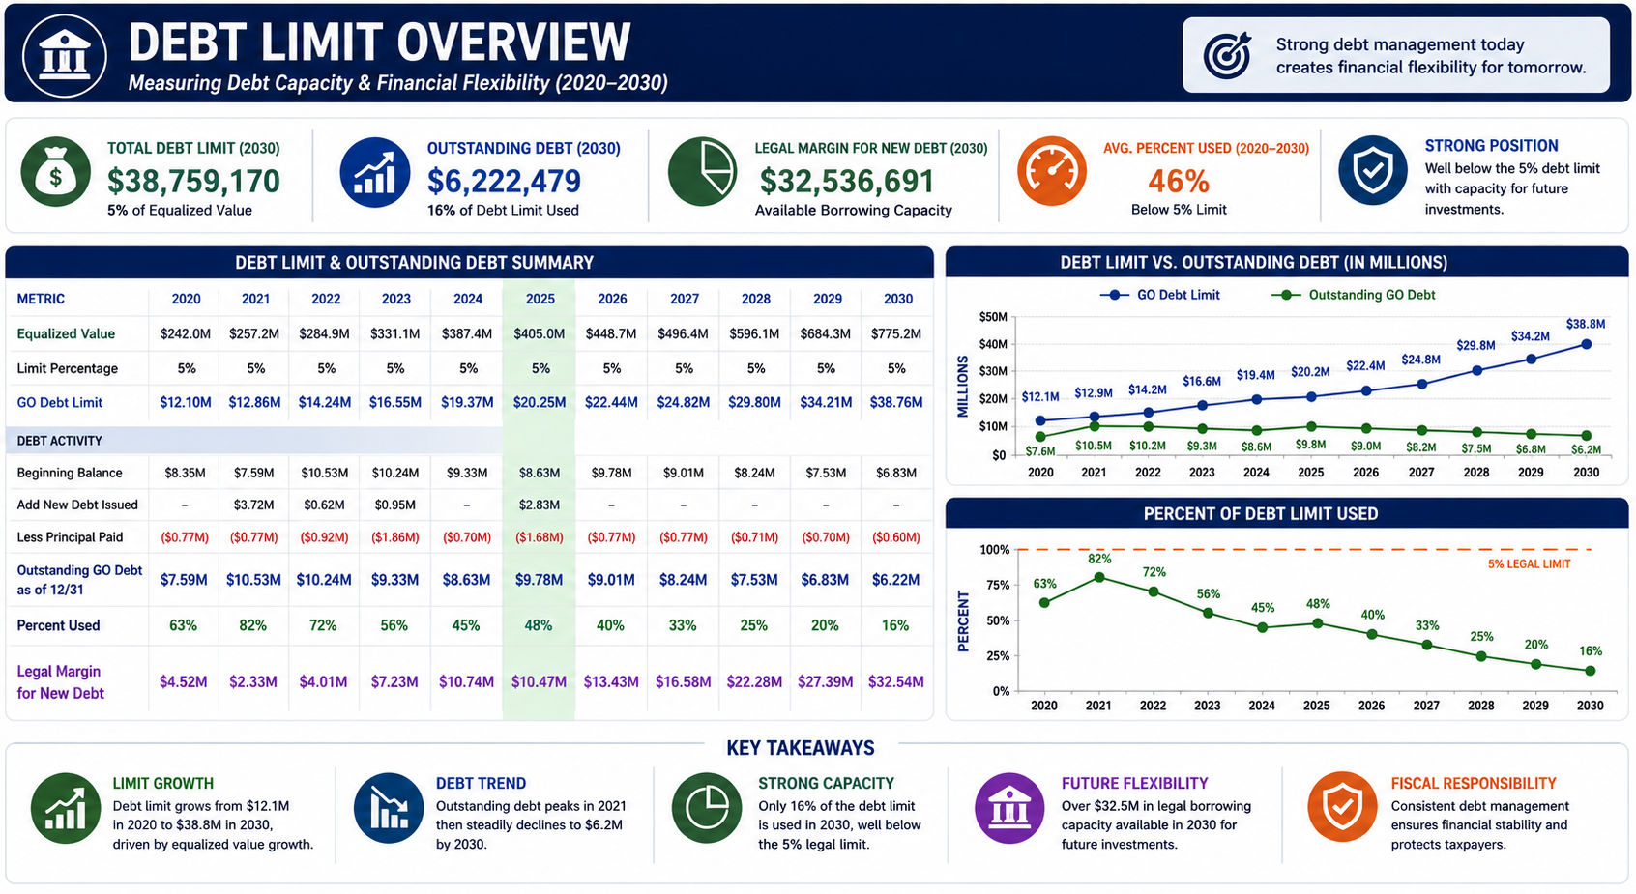
Financial Deep Dive

Slide 11
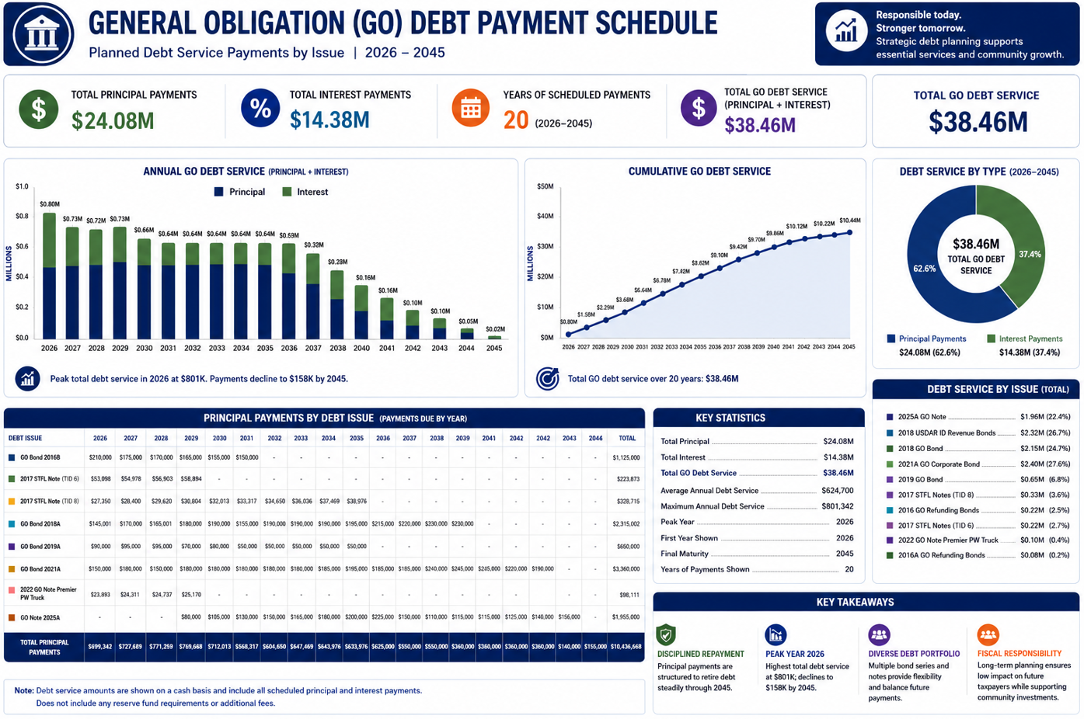
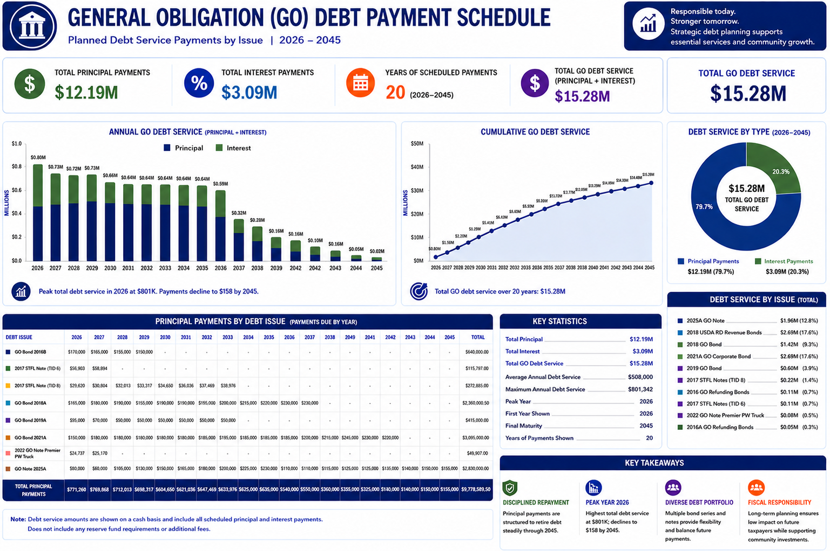
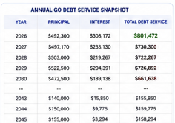
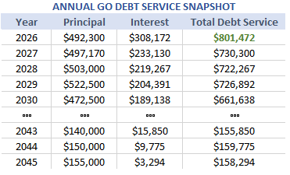
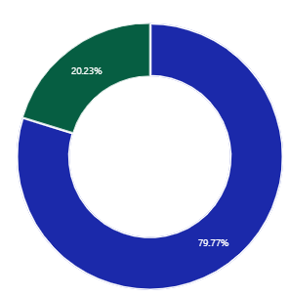
Financial Deep Dive
$12.18M
$3.09M
$15.2M

Slide 12
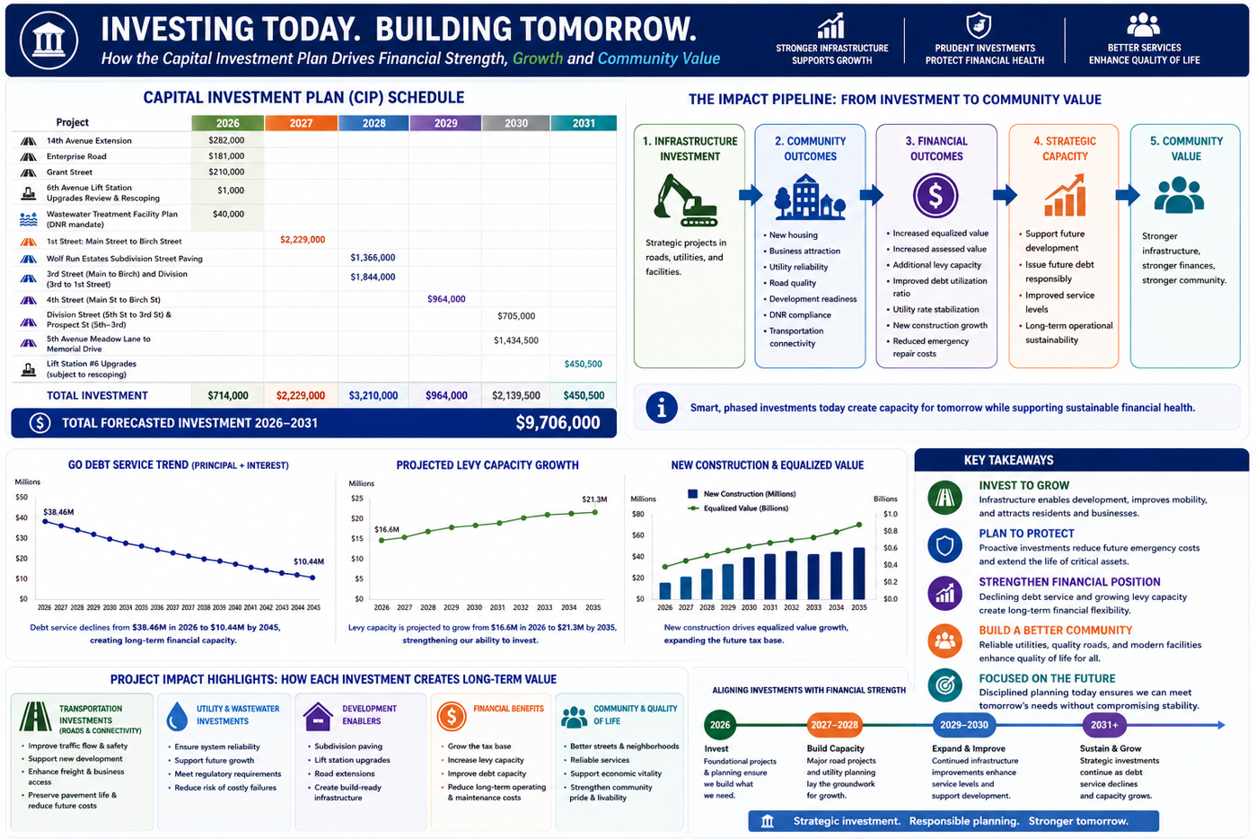

Slide 13
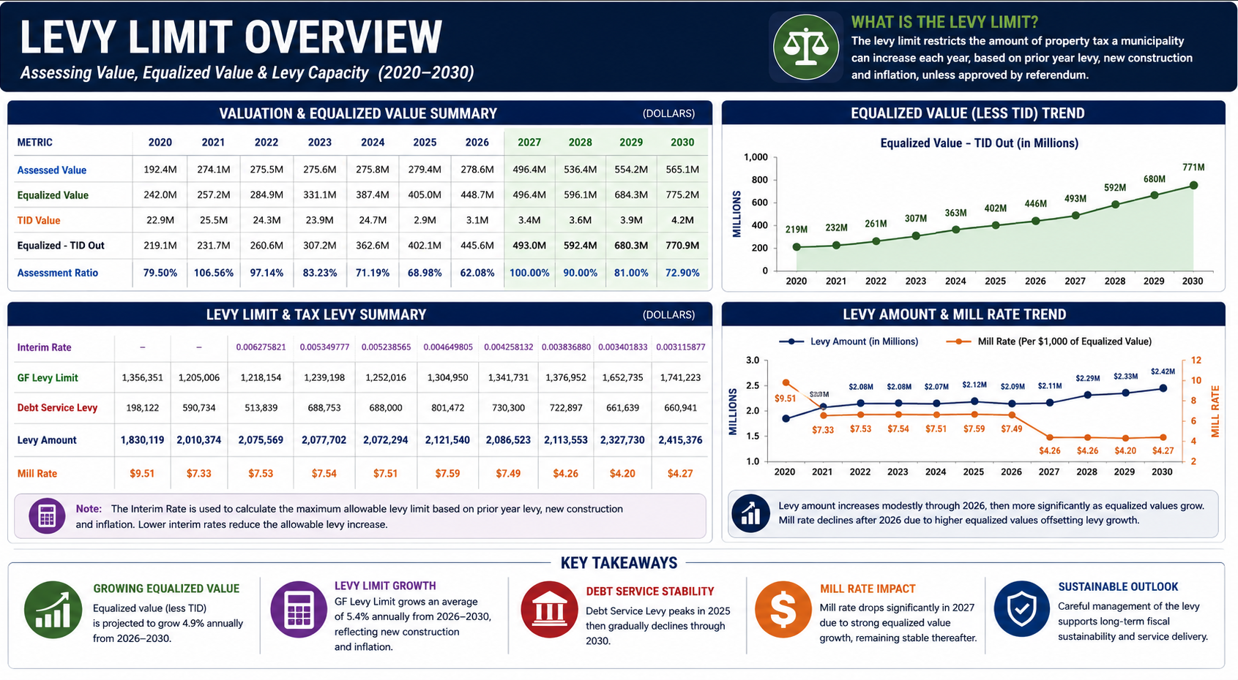
Financial Deep Dive

Slide 14
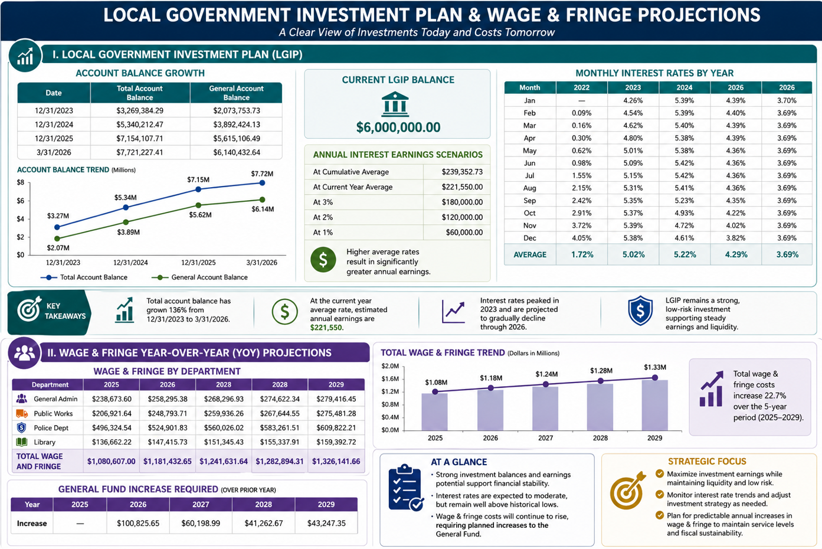
Financial Deep Dive

Slide 15
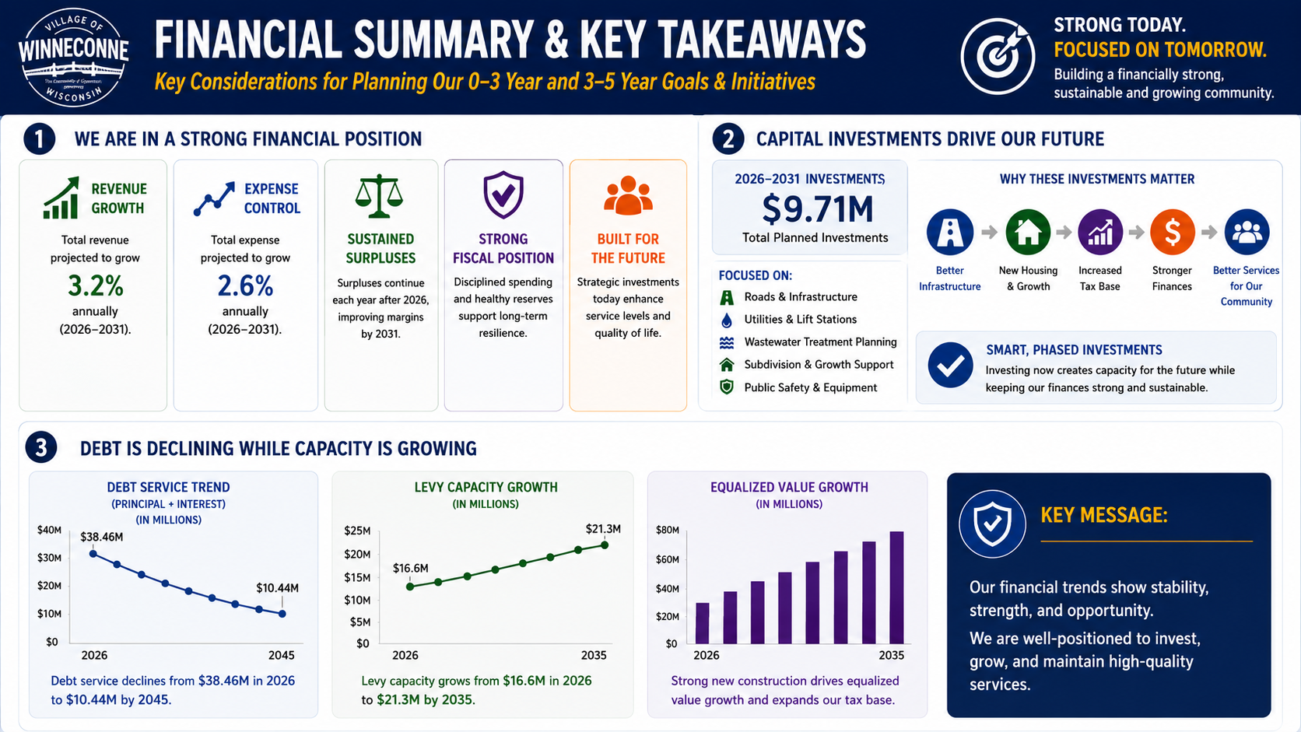
Financial Deep Dive

Slide 16
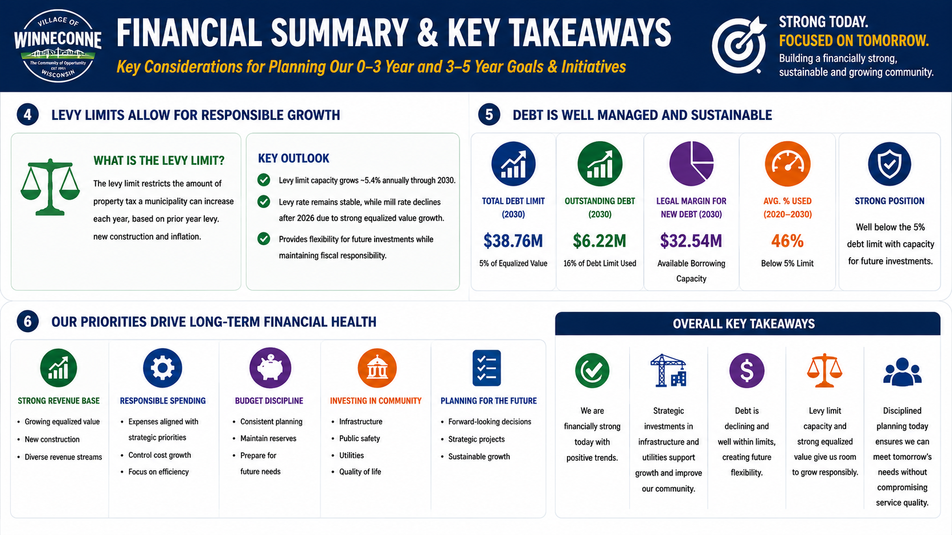

Slide 17
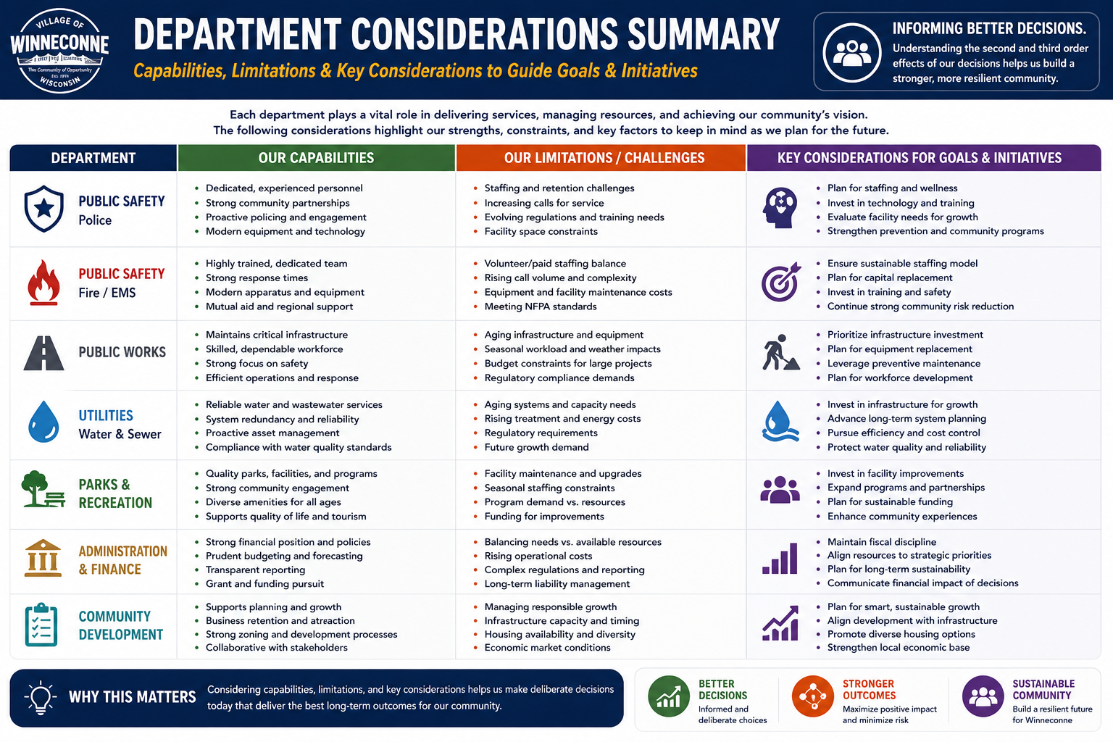

Slide 18
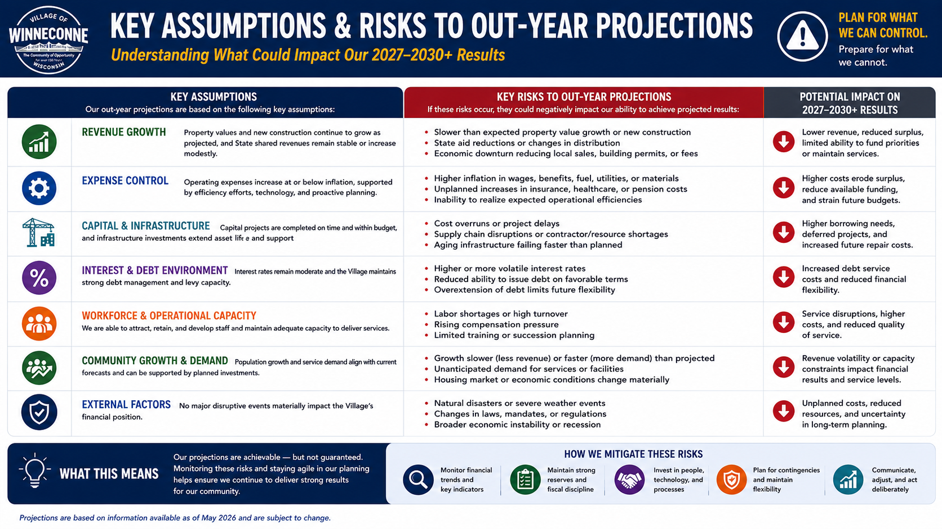

Slide 19
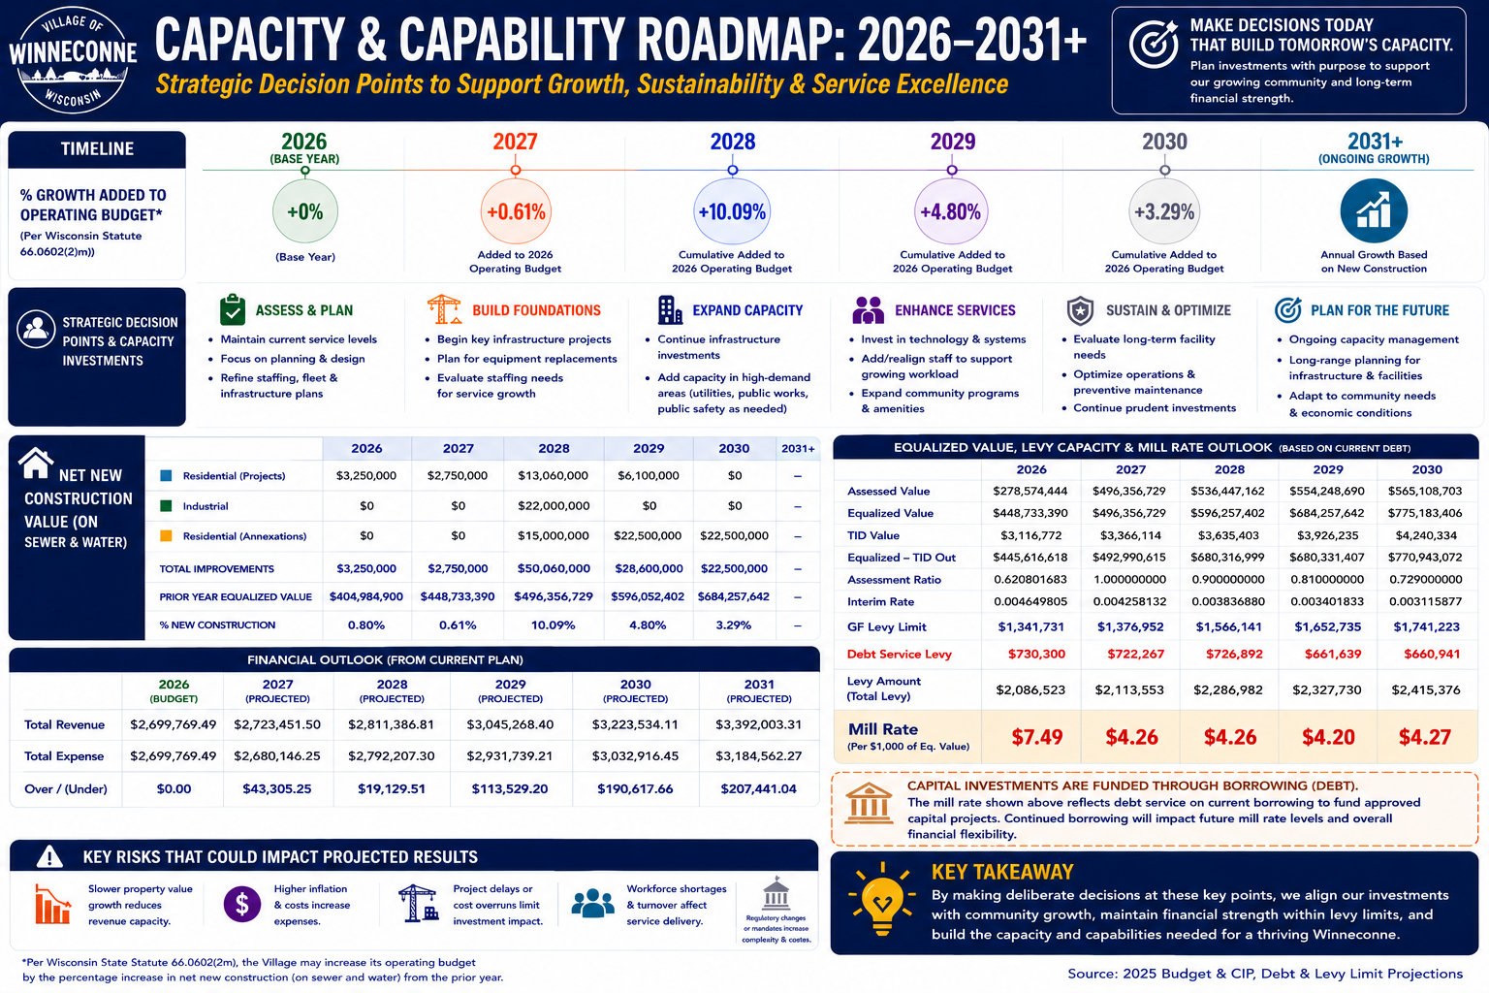

Slide 20
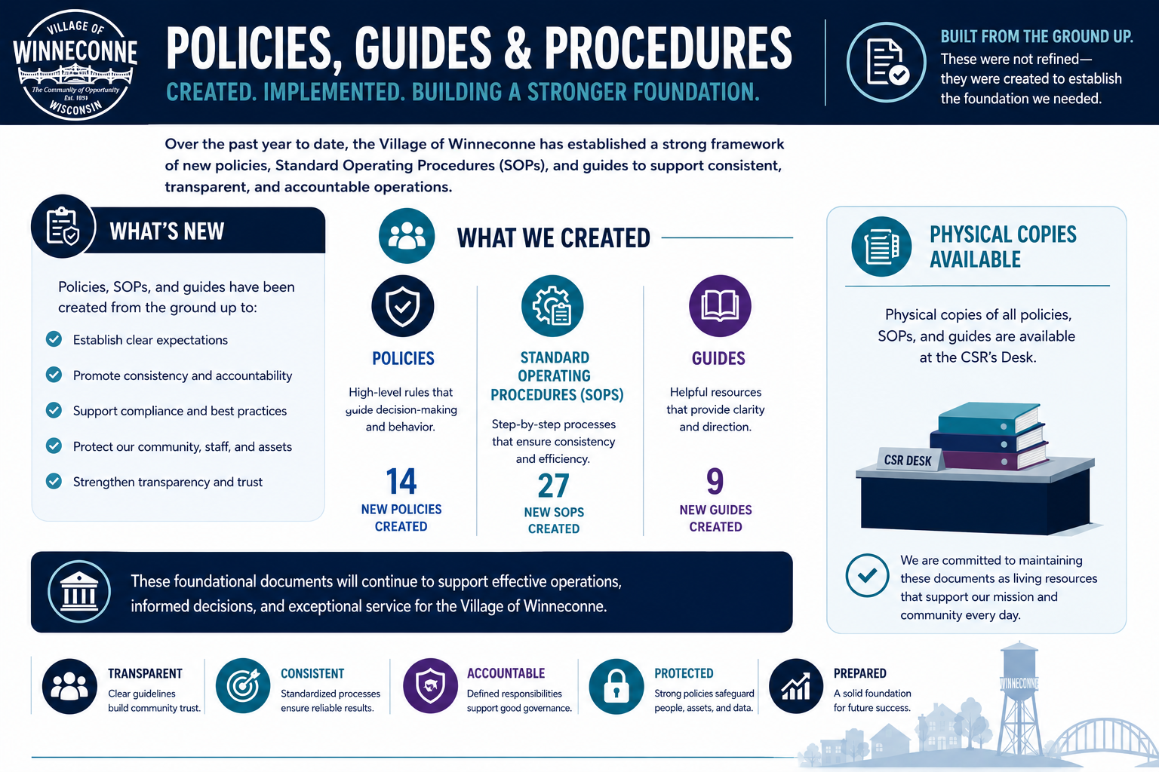

Slide 21


Slide 22
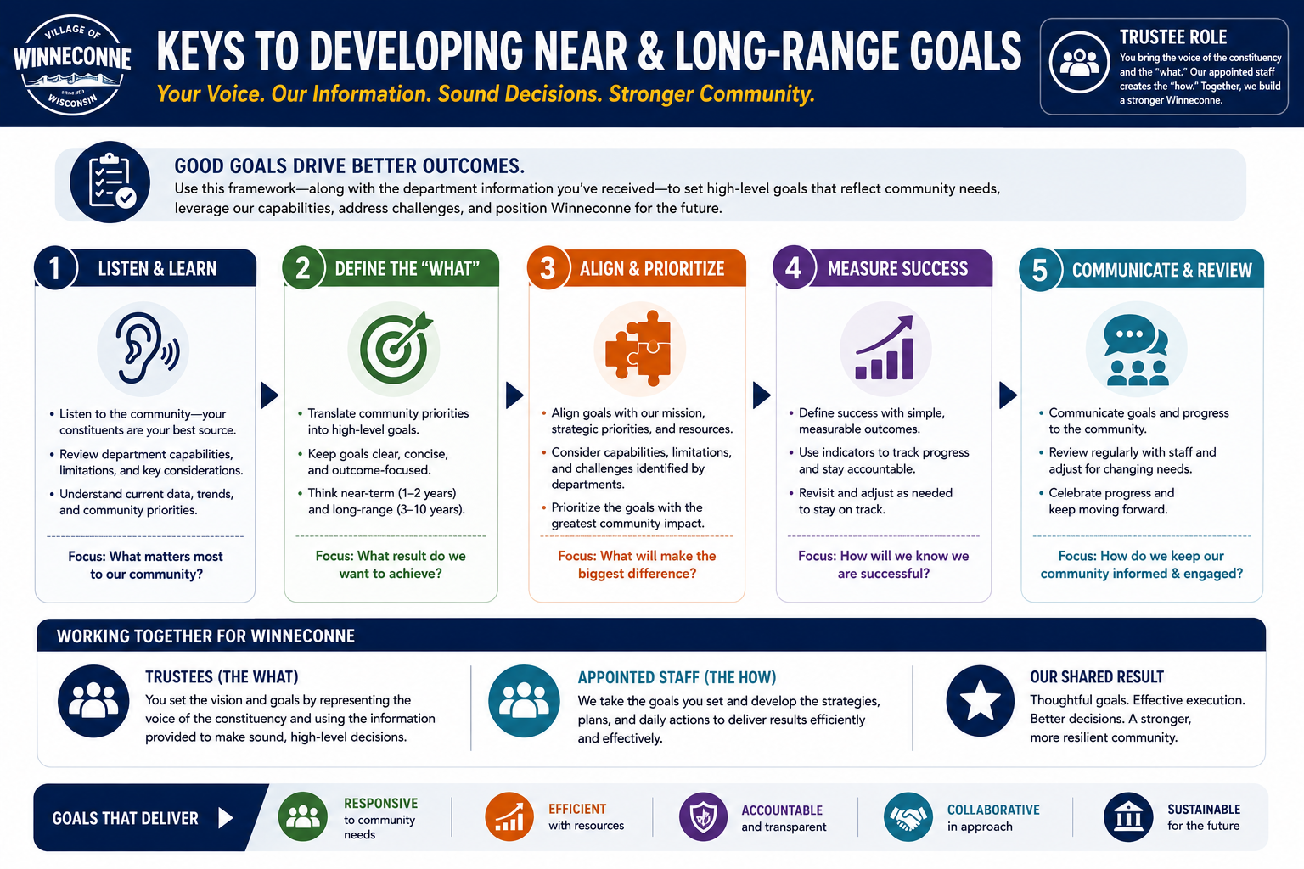

Slide 23


Slide 24
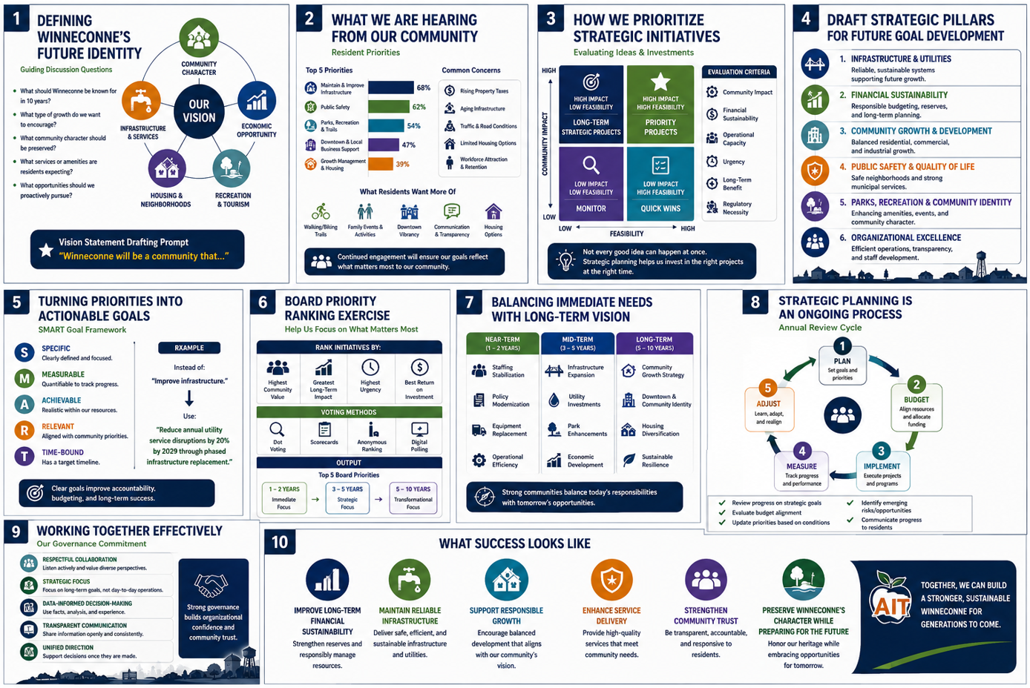

Slide 25


Slide 26
